Slide 1
Mindful Listening and Sharing
PSY 611A Exercise
Dr. Caroline Paltin

Slide 2

Mindful listening is an important skill and can be a great mindfulness exercise. In general, people thrive when they feel fully “heard” and “seen.” In other words, mindful listening involves a form of self-regulation in which the focus on the self is set aside

Slide 3
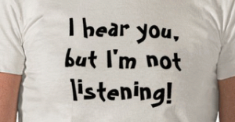
Mindful listening can create an inner stillness in both parties as the speaker may feel free of the listener’s preconceptions and prejudices, and the listener is free of inner chatter whlile learning valuable positive communication skills.

Slide 4
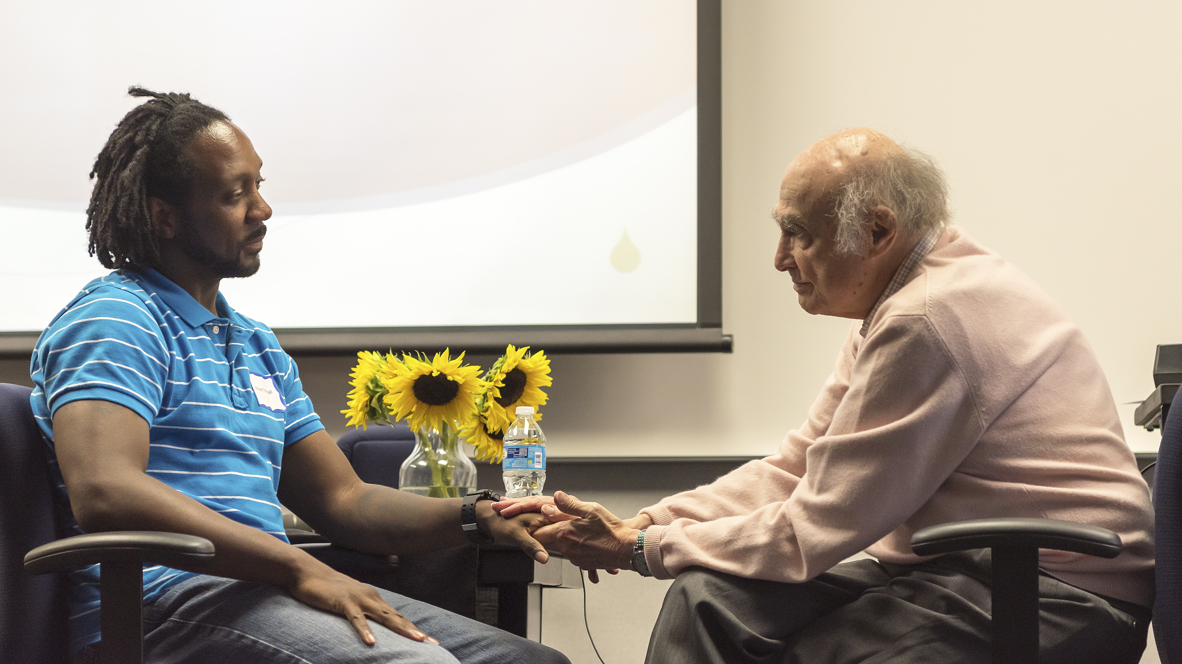
Much of our work involves assisting people in improving their ability to listen to themselves. Many therapists lack this important and crucial therapeutic skill or focus on their own thoughts more than listening actively.
Dr. Erving Polster and student in engaged in live therapy demonstration 2015

Slide 5
Listening and Reflecting Practice Excersize
Step 1: think of one thing you are stressed about and one thing you look forward to.

Slide 6
takes their turn in sharing your story with the group,

Slide 7
direct attention to how it feels to speak, how it feels to talk about something stressful as well as how it feel to share something positive.

Slide 8
Observe your own thoughts, feelings and body sensations both when talking and listening.

Slide 9
break into small groups and answer the questions I am about to show you.

Slide 10
How did you feel when speaking during the exercise?
2: How did you feel when listening during the exercise?
3: Did you notice any mind-wandering?
4: If so, what was the distraction?
5: What helped you to bring your attention back to the present?
6: Did your mind judge while listening to others?
7: If so, how did “judging” feel in the body?
8: Were there times where you felt empathy?
9: If so, how did this feel in the body?
10: How did your body feel right before speaking?
11: How did your body feel right after speaking?
12: What are you feeling right now?
13: What would happen if you practiced mindful listening with each person that you spoke with?
14: Do you think mindful listening would change the way you interact and relate with others?
15: How would it feel if you set the intention to pay attention with curiosity, kindness, and acceptance to everything you said and everything you listened to?

